Slide 1
Domain, Range, and Intercepts
Notes: 9/8

Slide 2
Domain
The set of all input values of a function. → x
Range
The set of all output values of a function. → f(x) or y

Slide 3
Domain and range of…
A table or ordered pairs:
(5,3), (8, -1), (20,4)
D: {-1, 5, 8, }
R: {-1, 3, 4}

Slide 4
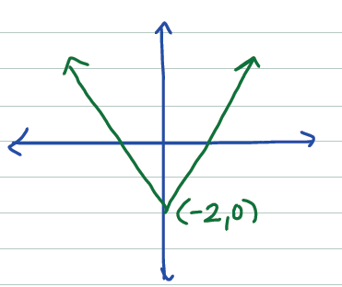
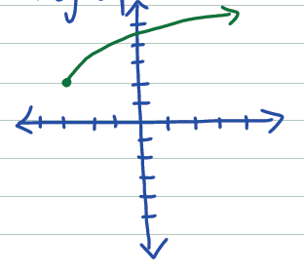
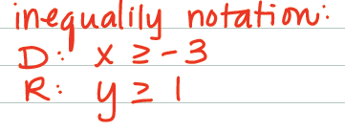
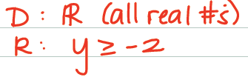
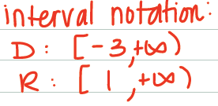

Domain and Range of…
A graph:

Slide 5
INtercepts
X-intercept: the point(s) where the graph crosses the x-axis
y-intercept: the point where the graph crosses the y-axis
To find the x-intercept, plug in zero for y and solve
To find the y-intercept, plug in zero for x and solve

